Slide 1

Portfolio
Kica Purton-Clark
Learning and Development Specialist
enter
Updated: Autumn 2025

Slide 2
Hello
Thank you for taking the time to explore my portfolio.
I created this document to showcase my experience, design process, creativity, and approach. Due to confidentiality and NDA agreements, you are viewing a redacted version.
For the best experience, please view it in ‘Slide Show’ mode or as a PDF. This document must not be shared, distributed, or copied without my explicit written consent.
back
begin
Updated: Oct 2025

Slide 3





highlights – click to see more
storyboarding
virtual training
inclusion
e-learning
back
presentations
templates
end

Slide 4

e-learning (compliance)
Using Articulate Storyline, I created compliance training for the UK’s flag carrier airline.
This project involved creating and refreshing resources to address specific learning objectives and operational requirements, including:
E-learning
Classroom materials
Instructor notes
And powerpoint presentations
return
next

Slide 5

computer-based training
Using PowerPoint, I created interactive induction training content and templates for a luxury New York fashion brand, ensuring it aligned with the brand's contemporary style and concept.
The training incorporated their commitment to inclusion to enhance the overall learning experience.
return

Slide 6
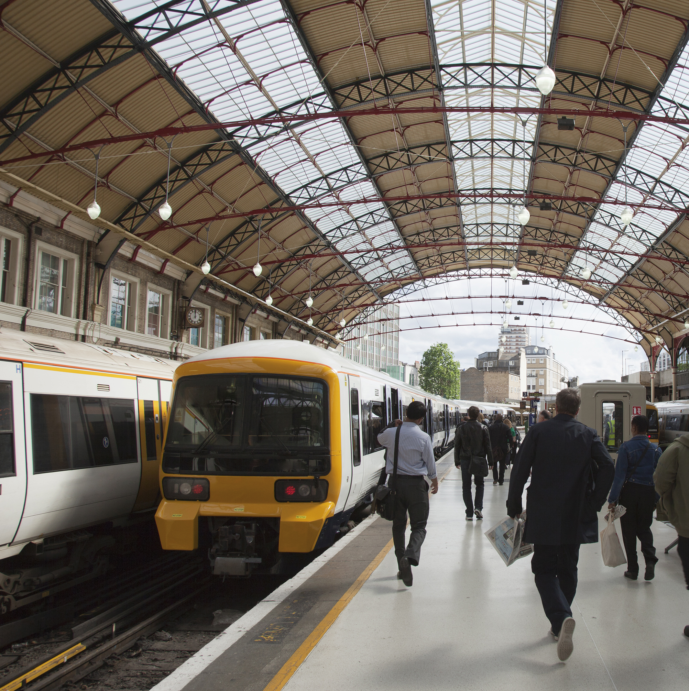
storyboarding
I designed and developed classroom training materials for a British rail infrastructure organisation that manages 20 of the country’s largest stations.
The project included:
Animation storyboarding and scripting
PowerPoint presentations
Learner resources
return

Slide 7

virtual training (compliance)
For a VIP airline in Bermuda, I designed, developed and delivered a 2-day leadership and management training course for two consecutive years .
The project included:
Instructor notes
PowerPoint presentations
Live delivery across five time zones
Live auditing by the Civil Aviation Authority (CAA)
return

Slide 8

inclusion
For the UK’s leading inclusion organisation, I redesigned and developed their product offering - impacting thousands of clients and their staff.
The project included:
Webinar development
PowerPoint presentations and templates
Pre-course learning
A learning design guide
An accessibility guide
return
next

Slide 9


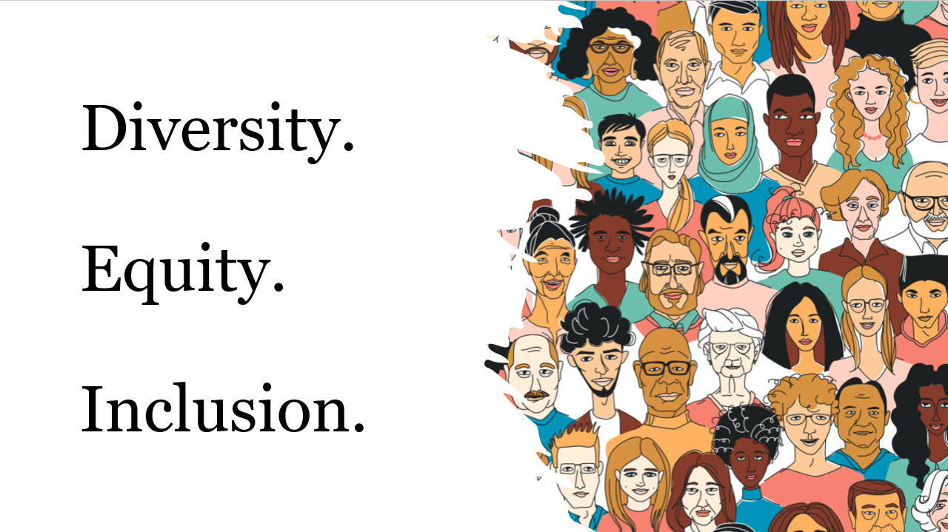
inclusion
I’ve designed and delivered multiple Diversity, Equity and Inclusion sessions via virtual training or face to face.
After identifying various needs, these upskills are designed to enhance awareness, sensitivity, and understanding, to create a more collaborative and supportive environment. They involve interactive group exercises and tasks for maximum engagement.
return

Slide 10


presentations – click to play
business proposal
microlearning
return

Slide 11

presentations
I created this business proposal for a training organisation interested in diversifying their product offering.
return

Slide 12

presentations
This 15 minute microlearning presentation explored the use of Artificial Intelligence in Learning and Development.
return

Slide 13
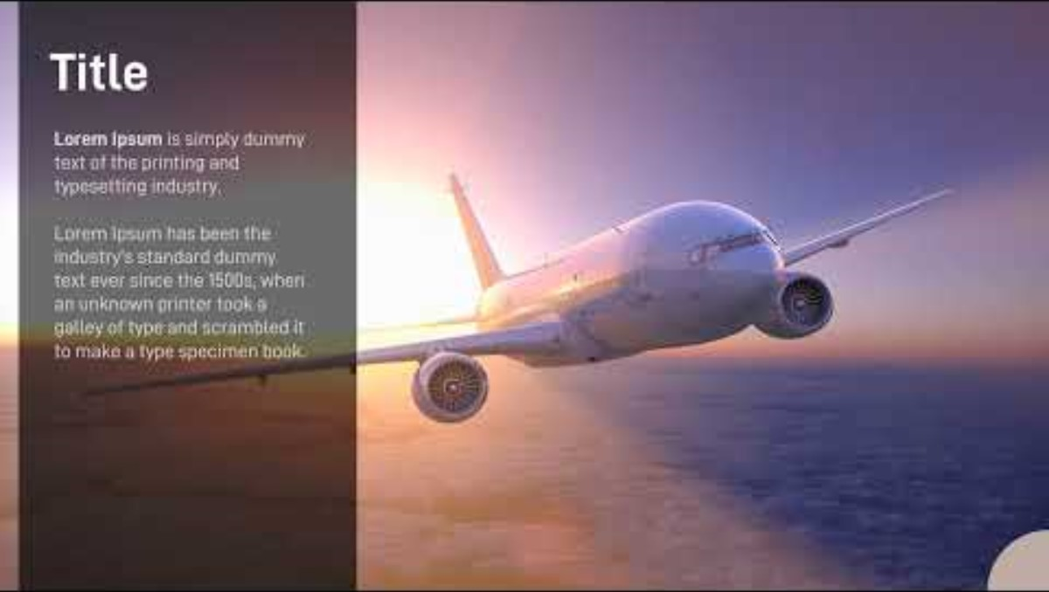
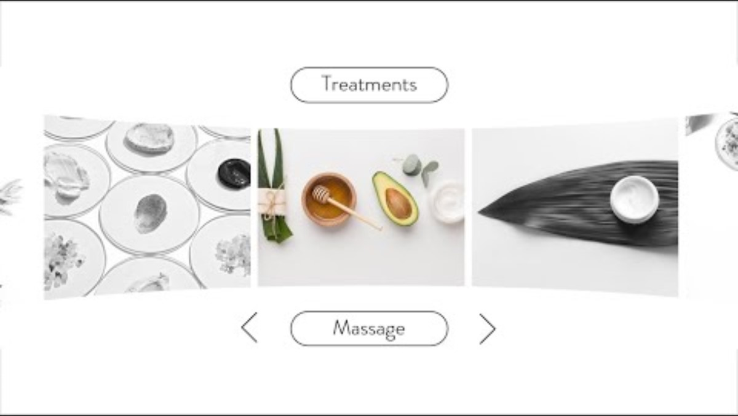
templates
return

Slide 14
thank you.
hi@kicapurtonclark.com
return

